Slide 1
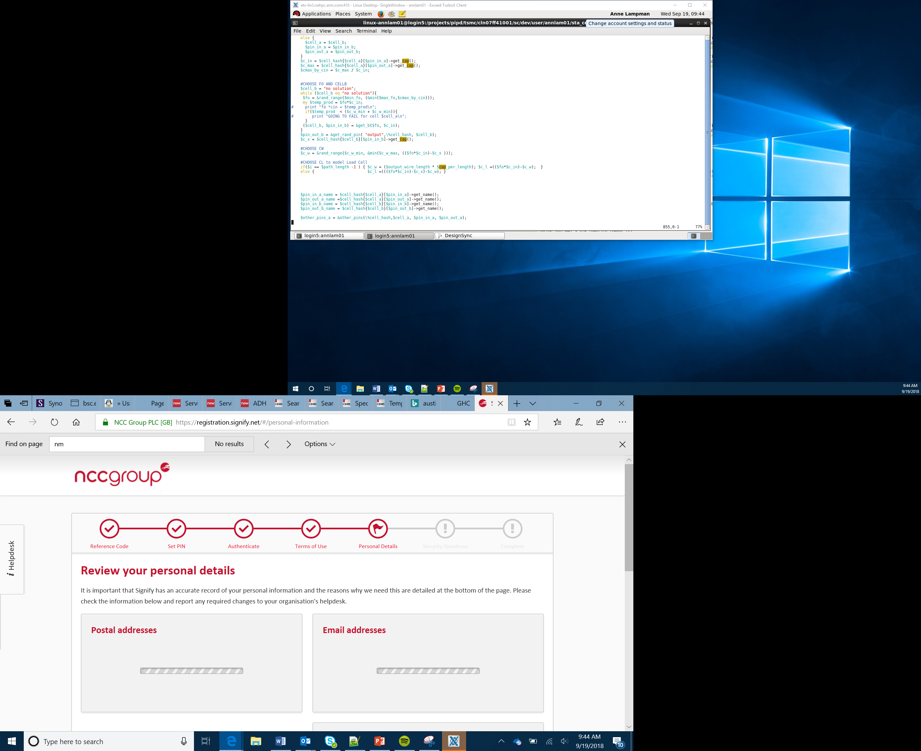

Orthographic Projection
Lesson 23

Slide 2
Objectives
Identify the three views needed for first angle orthographic projection
Represent a simple/single object using first angle orthographic projection
Represent a complex part using first angle orthographic projection
Identify the differences between first angle and third angle orthographic projection
Notes:
Introduce the objectives

Slide 3
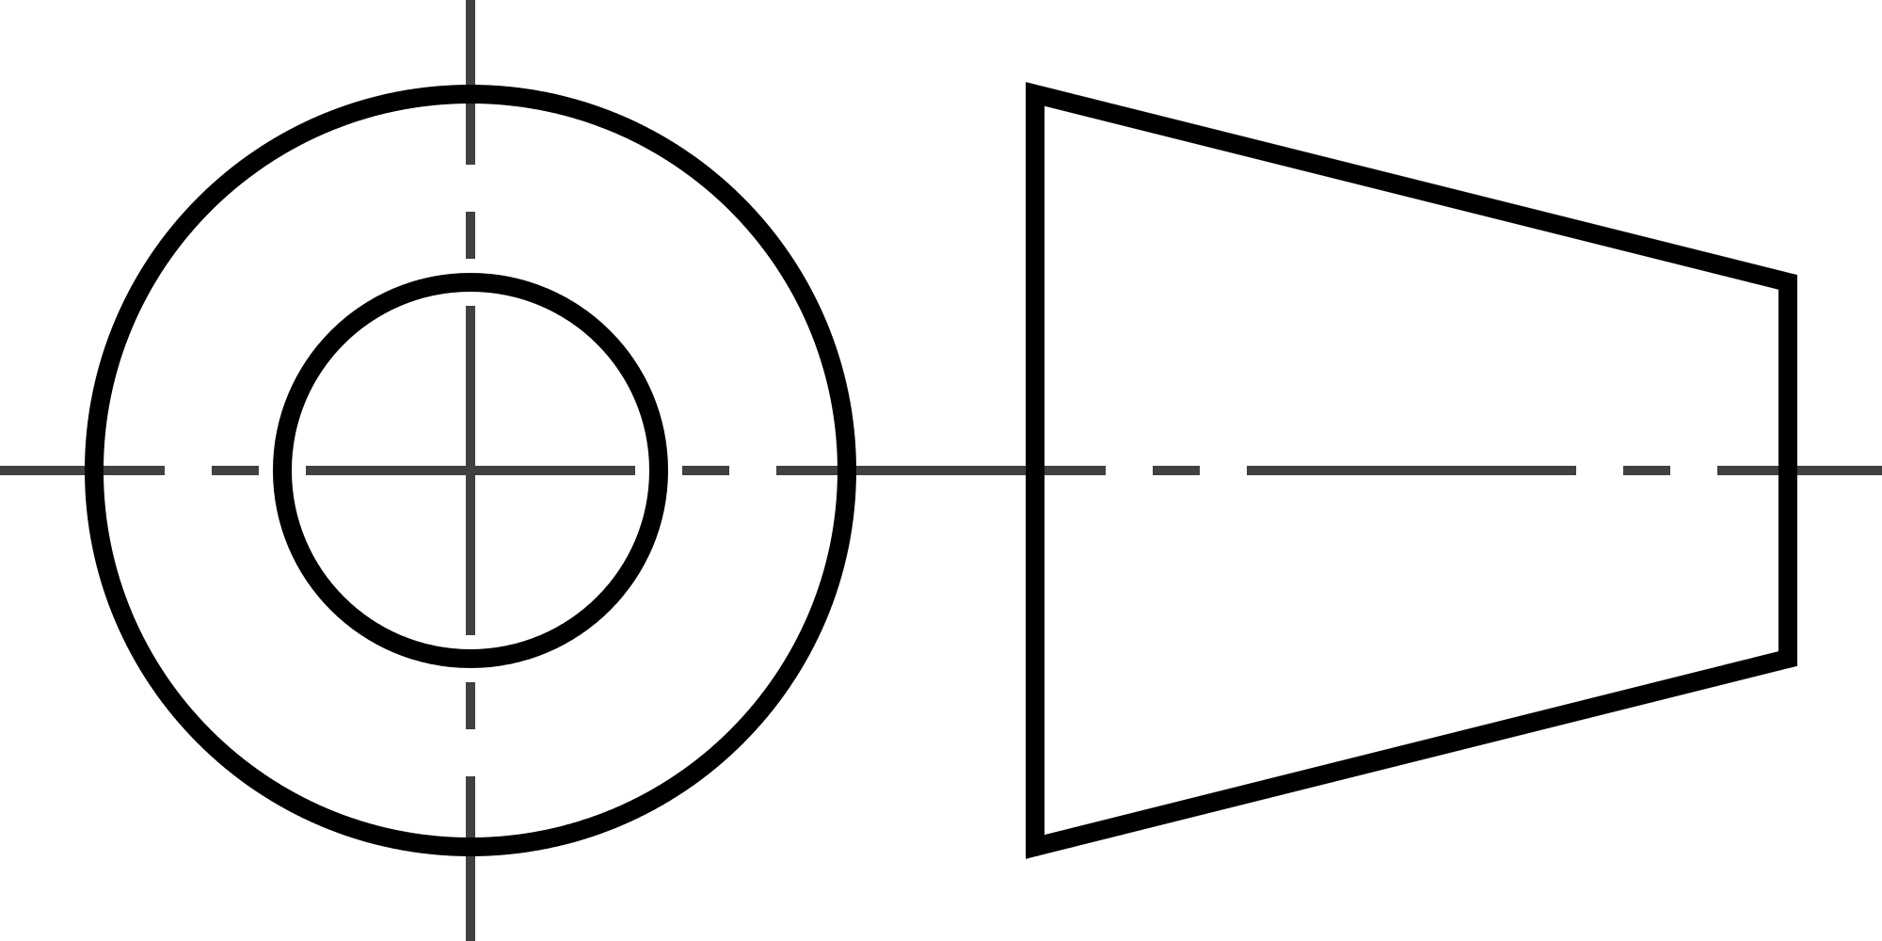
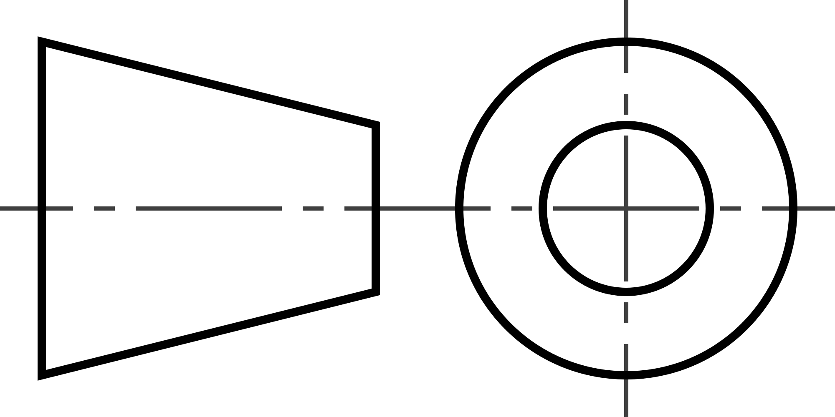
First Angle – Orthographic Projection
Orthographic Projection is a way of drawing a 3D object from different directions
Usually a front, side and plan view are drawn so you can see all the important sides
There are two ways of drawing an orthographic projection – first and third angle
The design sheets should be labeled using the appropriate symbols to represent which version is being used
Third Angle is mainly used as a standard in the USA and Canada where the rest of the world typically use first angle
First Angle
Third Angle
Notes:
Images tagged as free to use even commercial
The L shaped objects are my photos
Explain what orthographic projection is. Use a simple object to demonstrate the different ways of looking at it.
Tell Learners that we will use first angle but there is another method used in some countries call third angle. Show the symbols for each so that when student see plans online they will recognise which is being used.

Slide 4
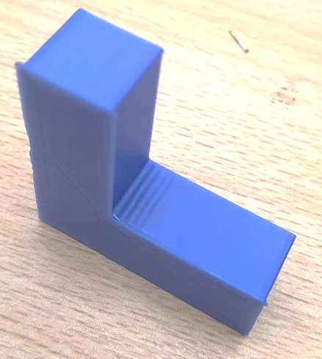
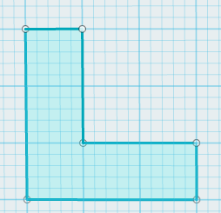
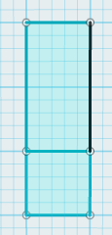
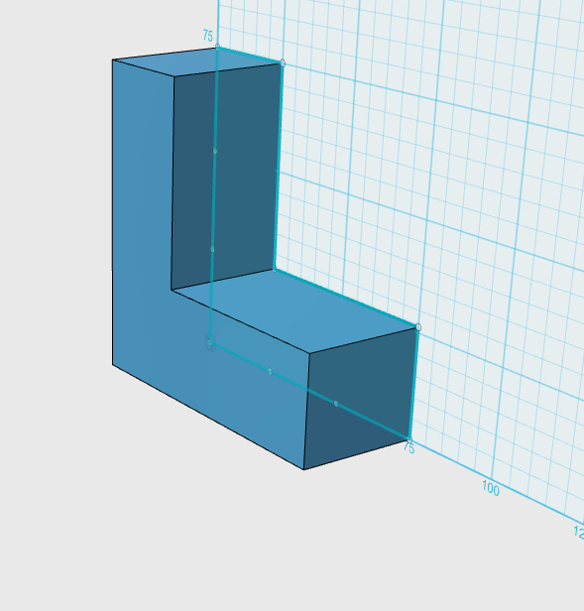
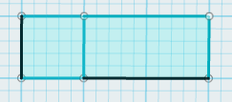
First Angle – Orthographic Projection
Right is an ‘L’ shape in 3D
In first angle projection we use three views:
Plan
Front
Side
PLAN
SIDE
FRONT
Notes:
Tell students that orthographic projection uses three views
Plan
Front
Side
Remind Learners of third angle and that the only difference between first and third is the order these views are presented on the plans

Slide 5
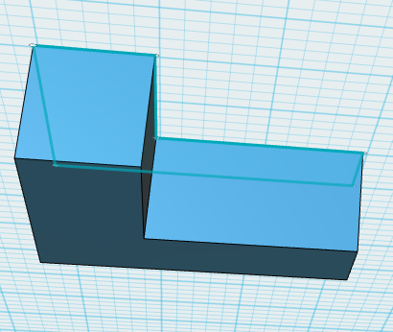
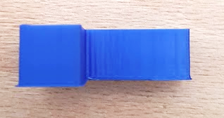
First Angle – Orthographic Projection
Plan View
The plan view is often referred to as the birds eye view
Imagine standing directly above the shape and draw what you see
Notes:
Discuss plan view or birds eye view
Use a simple object to demonstrate.
You can use a visualiser here of a streamed image from a mobile phone to demonstrate these views on the classroom display

Slide 6
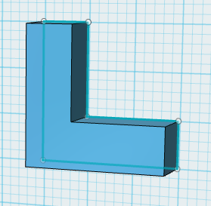
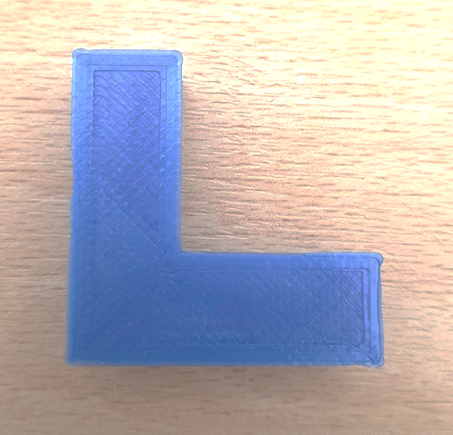

First Angle – Orthographic Projection
Front View
Imagine standing directly in front of object
Draw the shape as you see it
Notes:
Discuss front view
Use a simple object to demonstrate.
You can use a visualiser here of a streamed image from a mobile phone to demonstrate these views on the classroom display

Slide 7
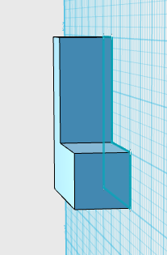
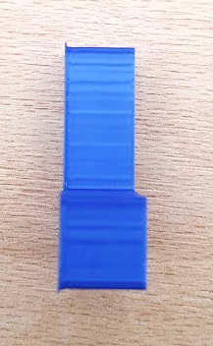

First Angle – Orthographic Projection
Side View
Imagine standing directly to the side of the object
Draw what you see
Notes:
Discuss side view
Use a simple object to demonstrate.
You can use a visualiser here of a streamed image from a mobile phone to demonstrate these views on the classroom display

Slide 8
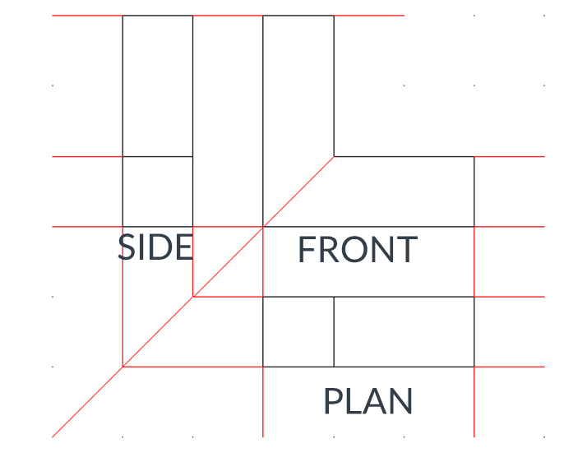
First Angle – Orthographic Projection
There is a correct method of presenting the three views in first angle orthographic projection
The drawing right is composed of a front, side and plan view of the object:
1 is the front view (drawn looking straight at the front of the L-shape)
2 is a drawing of the L-shape seen from the side (known as side view)
3 is a drawing from above, known as a plan view
The red lines are guidelines and are drawn to help keep each view in line, level and the same size
2
1
3
Notes:
Explain the order that is used for first angle and how guidelines are sometimes used to keep each view in line and the same scale

Slide 9
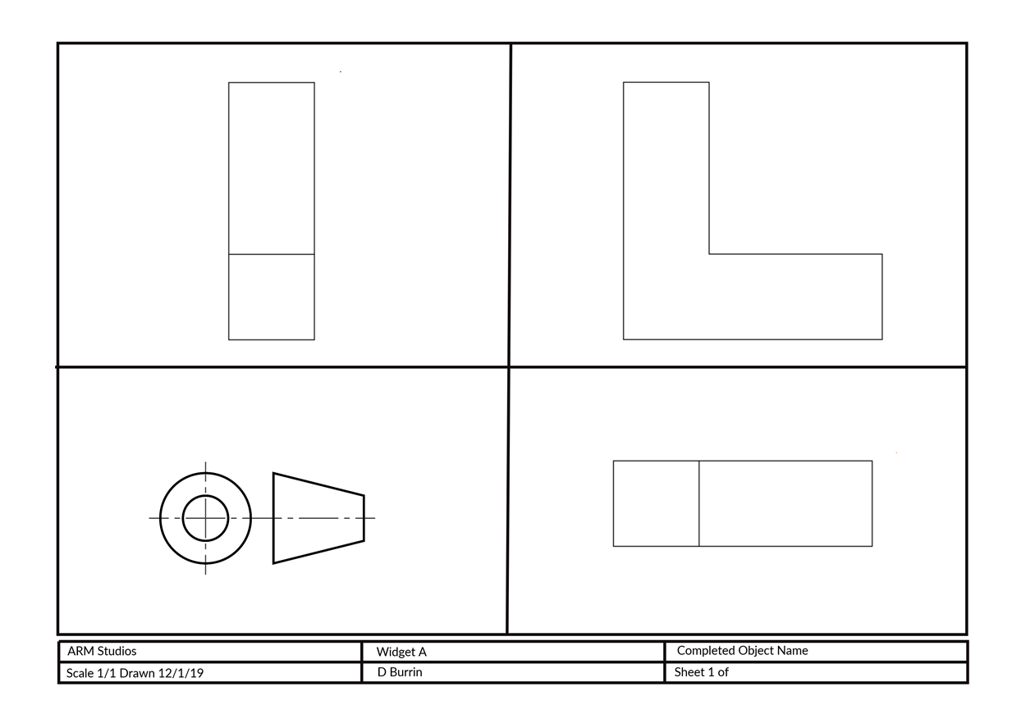
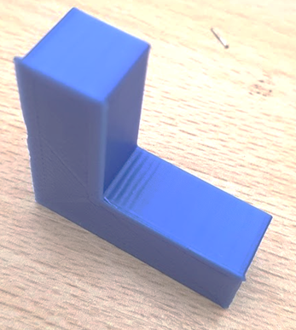
First Angle – Orthographic Projection
This may be then represented in a layout similar to the one below
Notes:
Explain how there are several different ways of presenting plans as first angle
Use the example in the slide to show one way of representing the plan
Explain that the plans are drawn to a set scale which is indicated on the plan so precise measurements can be taken

Slide 10
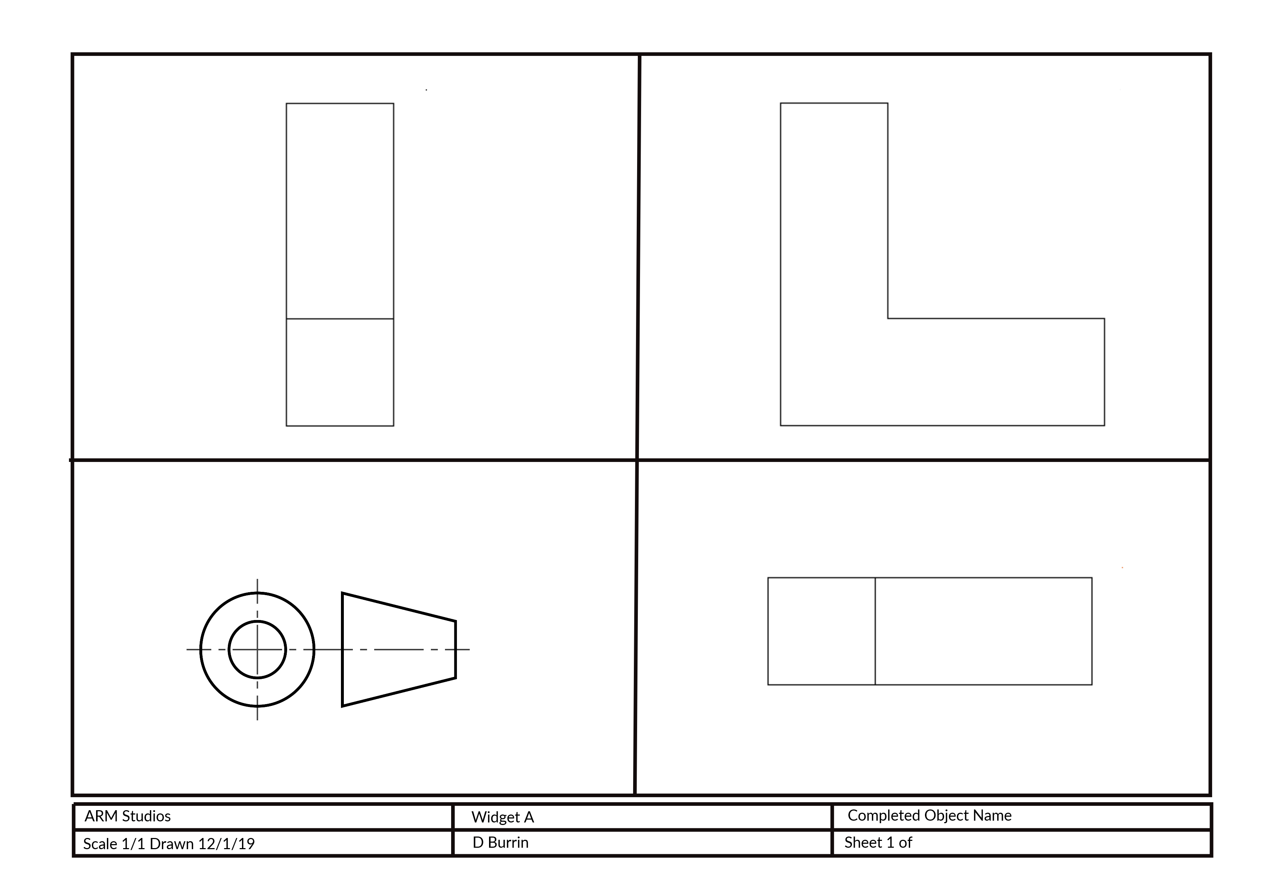
First Angle – Orthographic Projection
Using the layout style to the left complete the following exercises
Draw an H in First Angle projection
Draw fizzy drinks can in First Angle projection
Draw a pyramid in First Angle projection
Notes:
Use the template style as a basis for a set of exercises for Learners

Slide 11
Success Criteria
Identify the three views needed for first angle orthographic projection
Represent a simple/single object using first angle orthographic projection
Represent a complex part using first angle orthographic projection
Identify the differences between first angle and third angle orthographic projection
Notes:
Give the Learners the Activity Sheet and support them through the tasks
Encourage Learners to complete the Stretch Tasks

